Slide 1
De-Extinction
Mindy Phan
Arivan Verma
Notes:
AI is used in de-extinction technology for things like analysis of DNA of extinct species, creating new genomes, and simulating the behavior/ecosystem of these species.

Slide 2
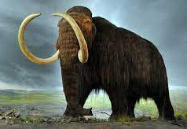
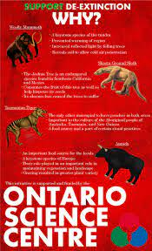
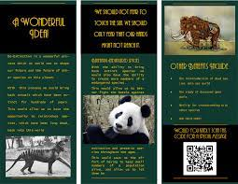
Overview
Slide 1: Title and Subtitle
Slide 3: History of De-Extinction
Slide 5: Timeline of Cloning Technology History
Slide 6: Plan and Implementation
Slide 7: Steps we can take
Slide 8: Pros of De-Extinction
Slide 9: Cons of De-Extinction
Slide 10: Summary
Slide 11: Bibliography
Notes:
Here is an overview of what we will be talking about. Click the slide for a shortcut to that topic of interest.

Slide 3
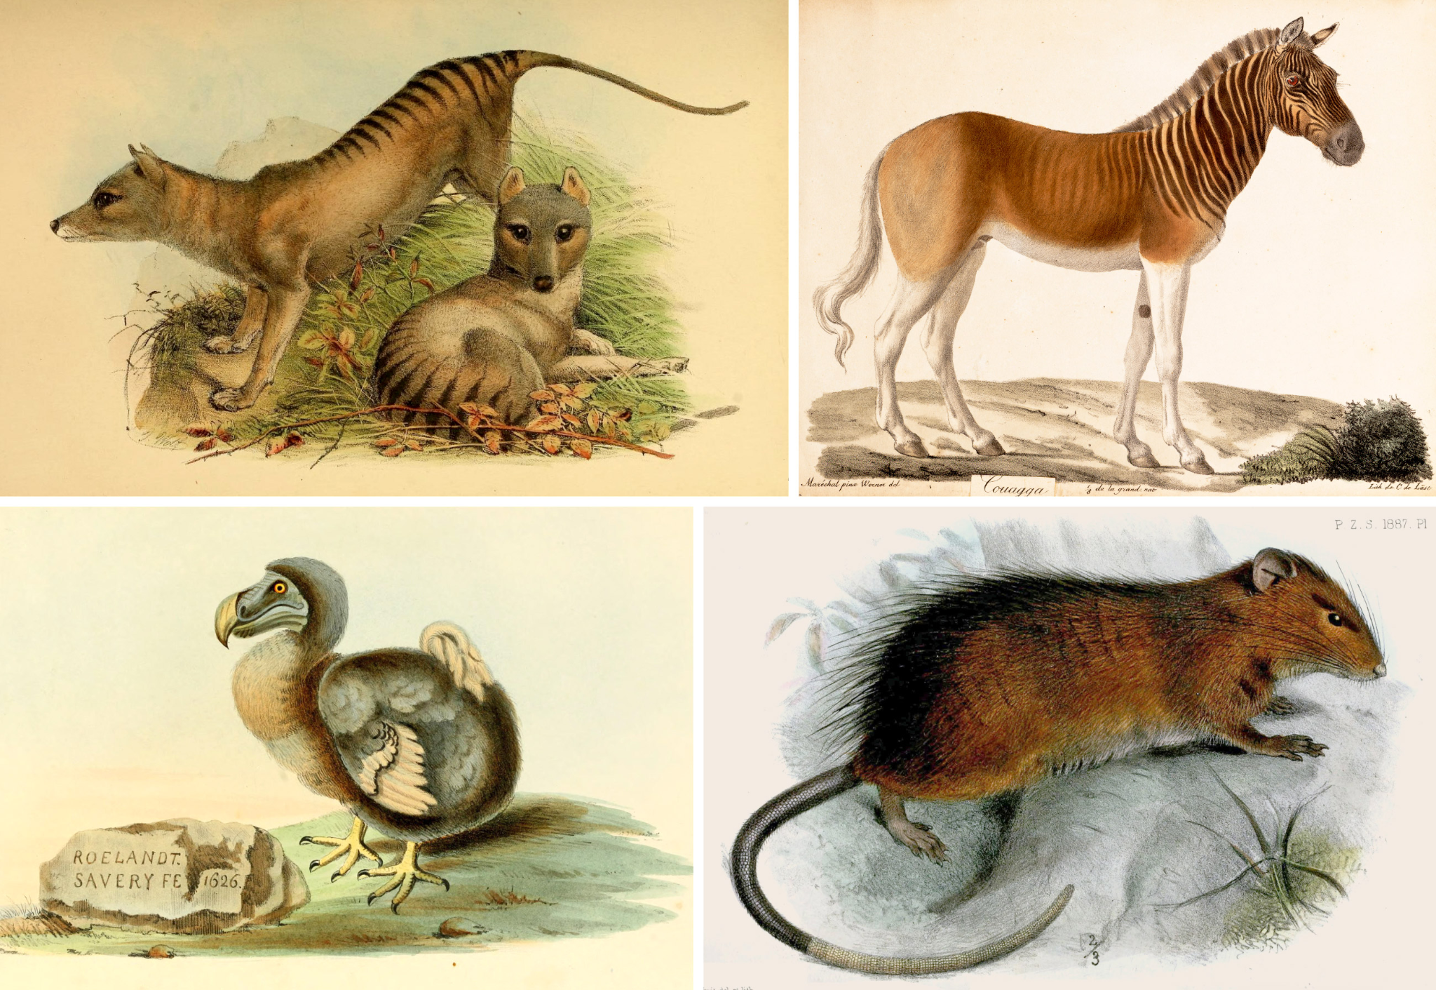
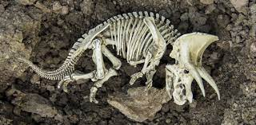
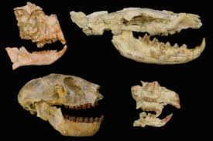
History, pt. 1
De-extinction is the goal of resurrecting extinct animals in the current day world. The goal is for an organism that resembles or actually is that extinct species.
A major historic event that catalyzed more investment into the idea of de-extinction was the development of somatic cell nuclear transfer (SCNT) that produced Dolly the sheep.
The first and only “successful” replication of an extinct species was the Pyrenean ibex (bouqetin/bucardo), which died after seven minutes due to lung malformation.
Notes:
De-extinction is the process of resurrecting animals that went extinct or are going to be extinct. The goal of de-extinction is to preserve animals and make sure that future generations and scientists can study then. This is a extremely new field of science and depends on AI in order to scan DNA and organize genetic information. One major scientific discovery that allowed for research into de-extinction was the development of somatic cell nuclear transfer (SCNT), which had been used in the cloning of the Dolly the sheep. There also has only been one successful experiment for de-extinction, in which an extinct species of baby bucardo was able to survive for seven minutes.

Slide 4
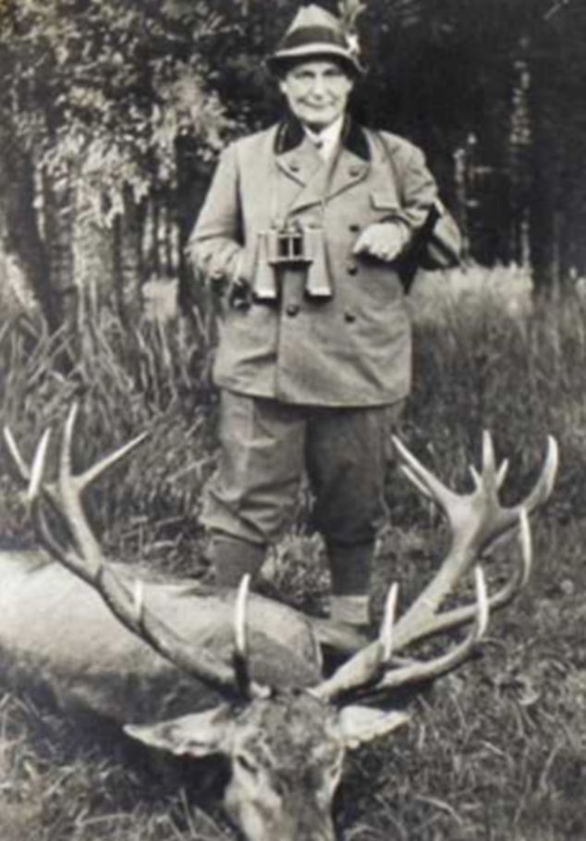
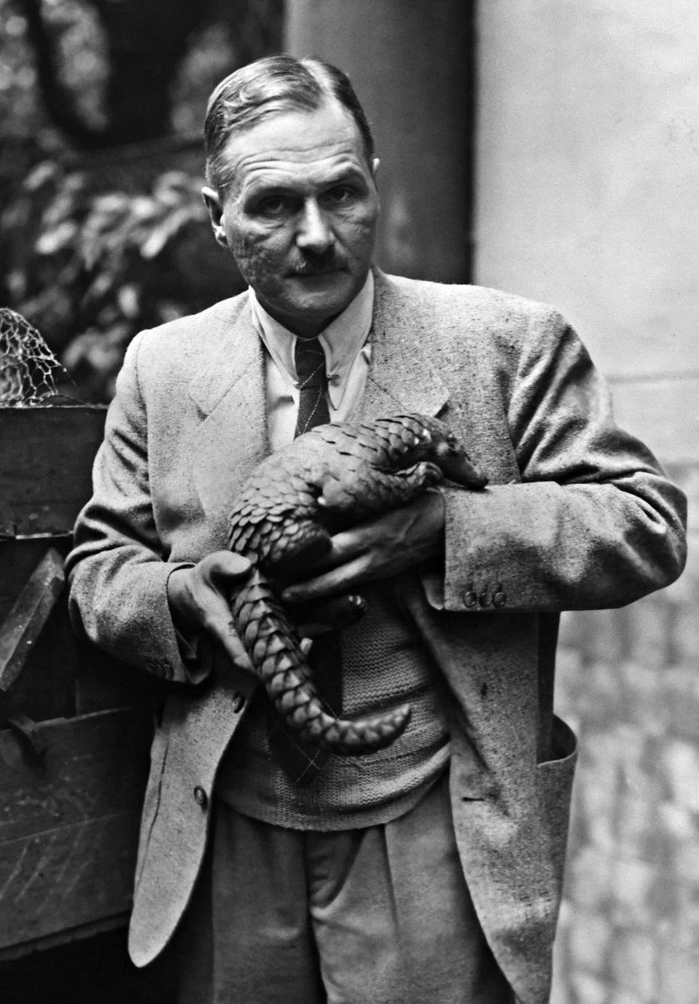
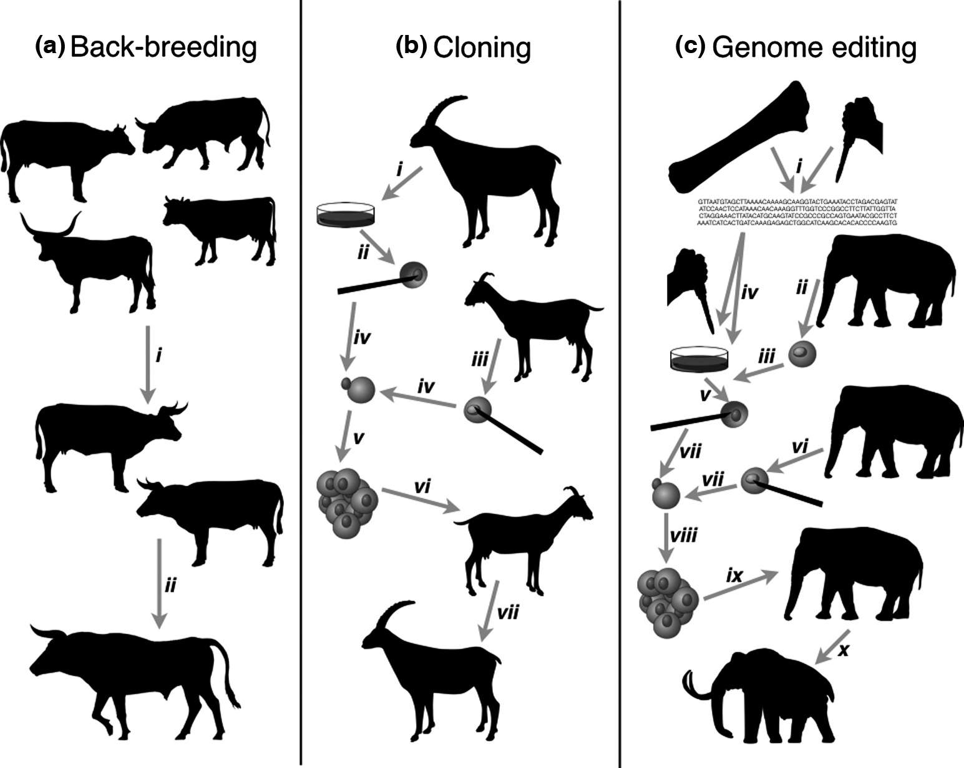
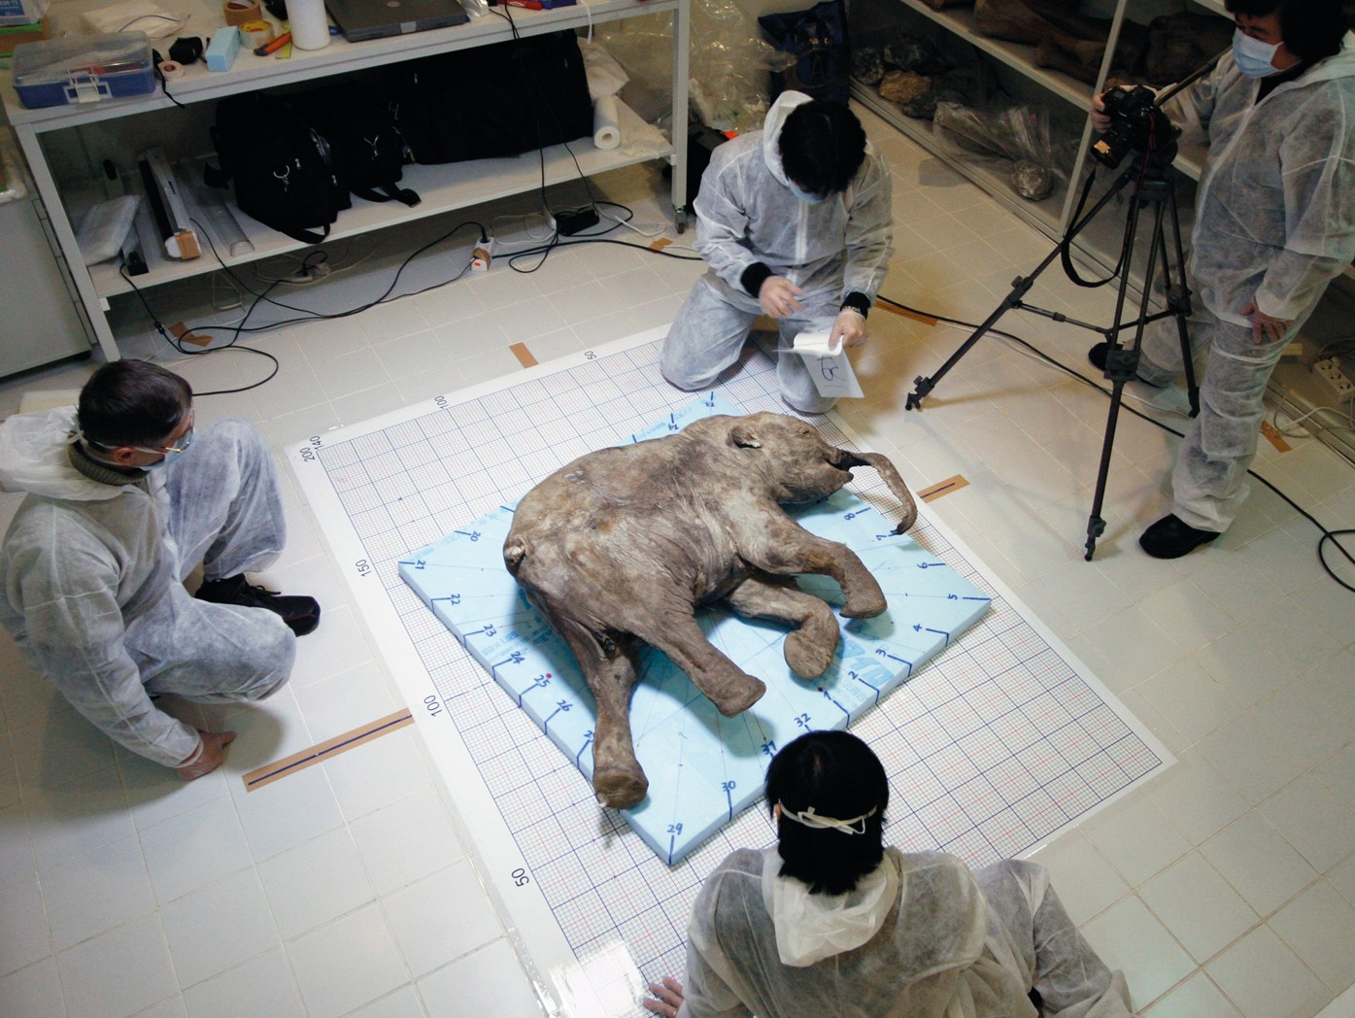
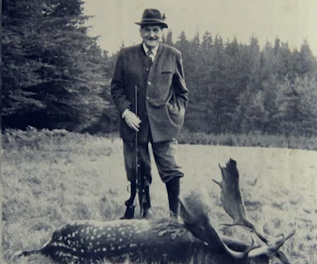
History, pt. 2
De-extinction was first conceived as an idea in the early 20th century as an approach to back breeding
producing a breed that has the traits of a wild ancestor
back breeding research done by German zoologists Lutz and Heinz Heck in 1920-30
Breakthroughs like tools for DNA isolation and analysis (bones, hair, tissues from dead animals) and in vitro fertilization were made in the later 20th century.
Notes:
This idea was first conceived in the early 20th century, and it was first considered during back breeding experiments. Back breeding was majorly researched by German zoologists Lutz and Heinz Heck in 1920 to 1930 when the Nazis tried to bring animals back from extinction. Back breeding attempts to produce a breed that has the traits of a wild ancestor. Throughout time, other technologies and discoveries (other than SCNT) that contributed to de-extinction include DNA isolation and analysis, in vitro fertilization, etc.

Slide 5
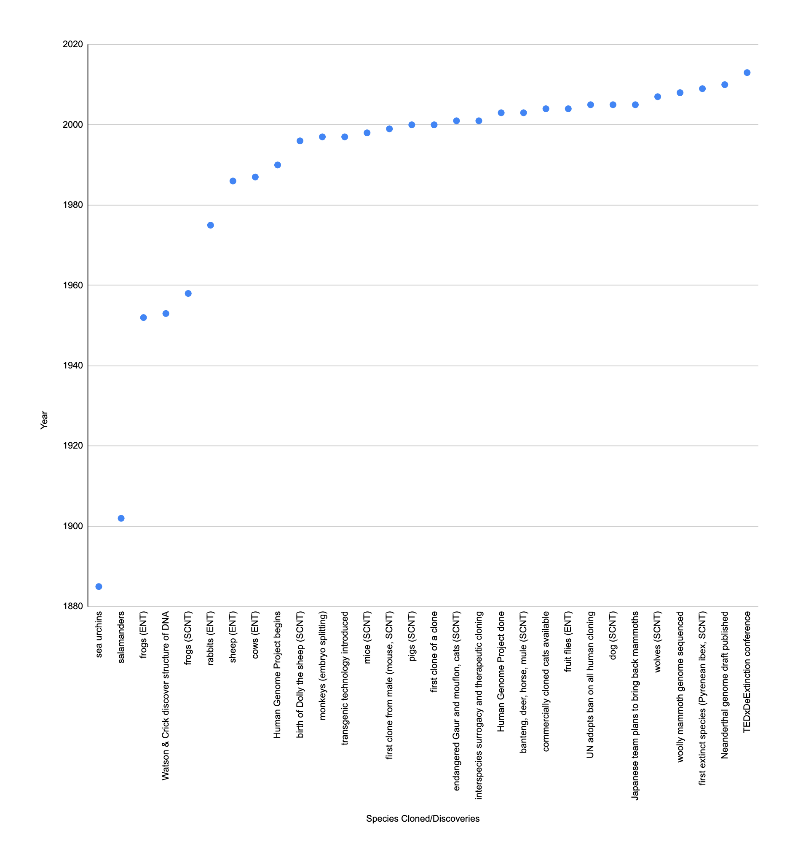
Timeline of Species Cloned/Cloning Technology
Notes:
There are three ways that cloning technology was approached: SCNT, ENT, and embryo splitting. (SCNT = somatic cell nuclear transfer; ENT = embryonic nuclear transfer) The graph above depicts the timeline of breakthroughs in cloning technology (including the first major conference hosted over de-extinction in 2013) and the various species that have been successfully cloned.

Slide 6
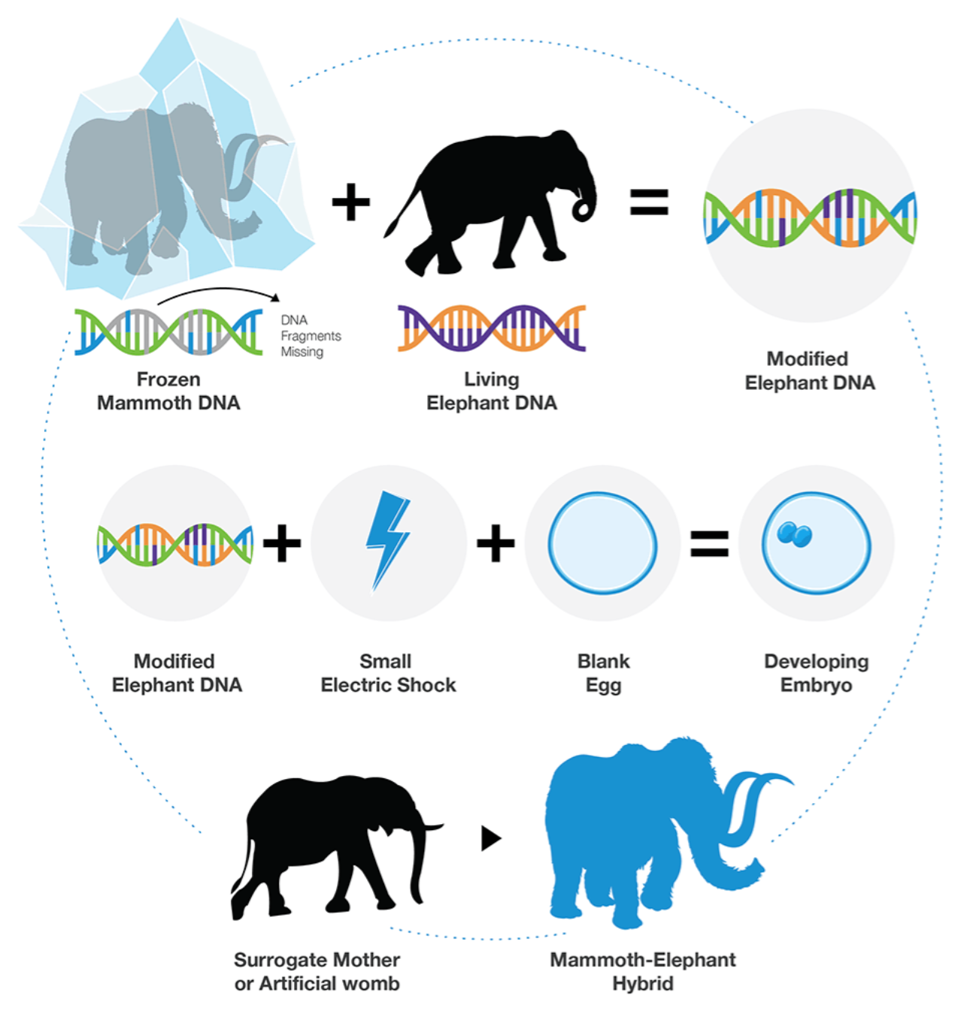
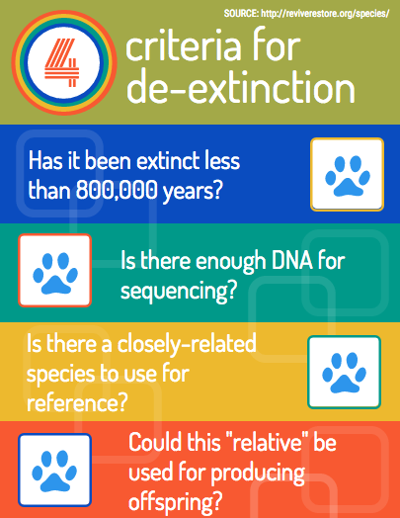
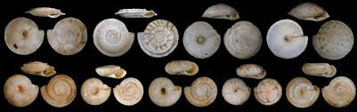
Plan and Implementation
The first step is to gather all possible DNA and genetic information scientists can find in the animal remnants.
Second, they would use artificial intelligence to try to genetically reconstruct the animal to the best of their ability.
AI use encompasses DNA analysis, creation of new genomes, simulation of habitat, etc.
Finally, they would put the animal in an ideal environment to
let evolution perfect the animal.
Notes:
The first step is to gather all possible DNA and genetic information scientists can get about a specific animal they want to replicate. Then they will use AI and other forms of technology to resurrect the animal to the closest possible fit, and then place them in the correct habitat that they are used to. There are also different questions that are necessary to be answered as an affirmative before an animal can undergo de-extinction; for example, it must have gone extinct within the last 800,000 years, and there must be a currently-existing animal that is similar to the extinct species to use as a reference (seen in the chart for de-extinction process on the right).

Slide 7
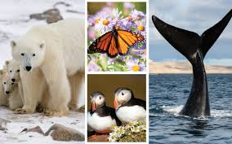
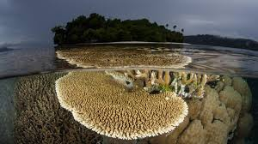
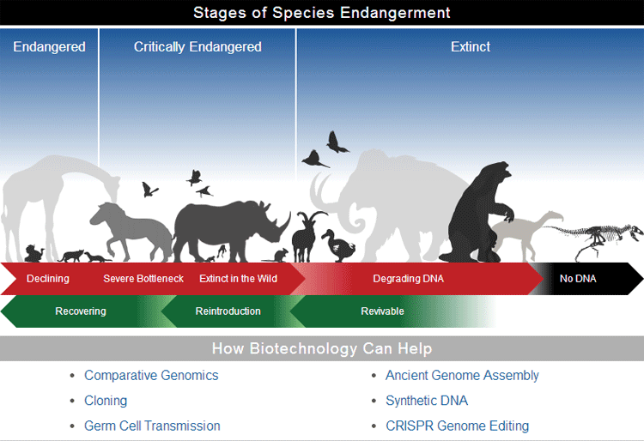
Plan and Implementation
Animals are relocated to a similar environment as their habitat when they were originally alive
ex: wooly mammoths will go to the Russian Tundra
Because scientists will not be able to ever get to the perfect animal even with 100% of the DNA, they will have to rely on evolution in order to make sure they get an animal as close to what evolution wants.
More research is being put into implementing de-extinction now as a last resort to solve the issue of species rapidly going extinct
partially due to natural disasters
but half of all species are projected to go extinct by 2050 due to human-caused events and disasters
Notes:
In the process of de-extinction, animals that have been resurrected will be placed in environments that are similar to that of what they had lived in prior to becoming extinct. Despite medical research and scientific knowledge being so advanced, scientists will never be able to create a 100% exact replica of the extinct animal, so they must depend on evolution to perfect the animal. Due to natural disasters and human-caused events, animals are rapidly going extinct. Researchers are investing a lot into de-extinction as a last resort to solve this impending issue, as well as to re-introduce animals that already died as an attempt to revitalize ecosystems.

Slide 8
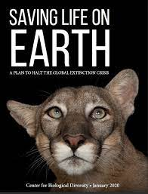
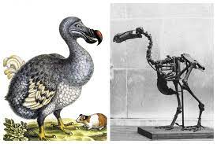
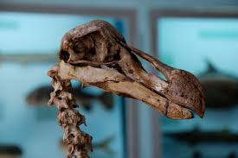
Pros of De-extinction
Recovers extinct animals
Plants, animals, and other organisms will be able to come back from natural disasters
Helps preserve current animals that are currently endangered
Allows us to study ancient animals in their old habitat
Notes:
Positives of de-extinction include: it can recover animals, it can save earth from rapid wildlife extinction, it can help scientists study animals in their old environment, and it can allow us to have a better understanding of the patterns/behaviors of creatures.

Slide 9
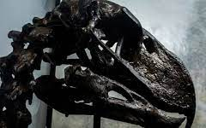
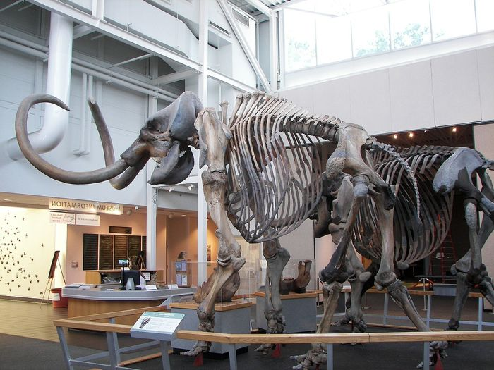
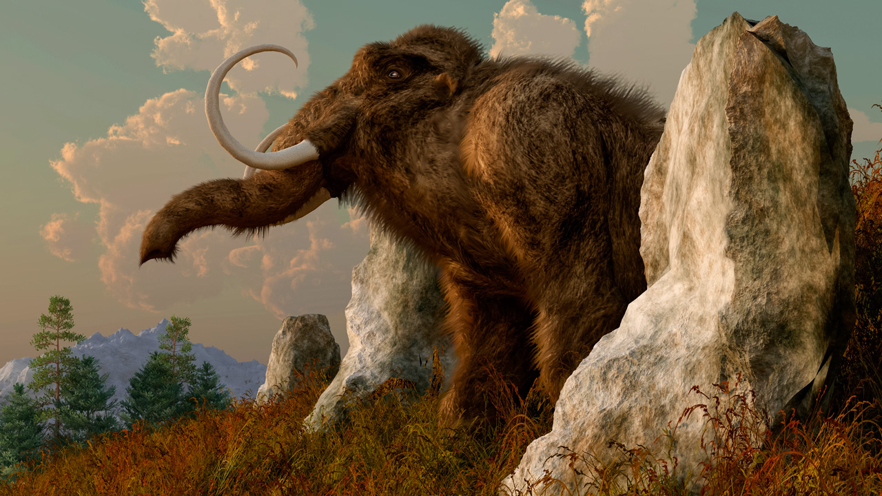
Cons of De-Extinction
Results in waste of limited DNA substances AND expensive
Takes resources from current conservation efforts → can’t maintain populations of currently endangered species
Strains habitat and wildlife resources
Differences in cloned animal vs original animal that went extinct
may have a different role in the food chain
its role may have been replaced, making it an invasive species
Still in progress and only has resurrected one animal for seven minutes
Notes:
Unfortunately, the positives of de-extinction are all highly theoretical, as there has been no successful instance of de-extinction other than the one case of the baby bucardo that survived for only seven minutes. There are many possible disadvantages of de-extinction, including the repeated use of DNA that may wear down our resources, ethical concerns as to whether animals will just be going through torture if there is a malfunction, concerns over the ethicality and morality of placing animals of de-extinction in zoos (which have a bad history of animal treatment), and environmental and financial costs. Additionally, because no recreated animal will be 100% exact to the originally extinct species, there is a possibility that the new animal may have a different role in the food chain and disrupt the current ecosystem. Additionally, the ecosystem may have already adjusted for the extinction of that animal, meaning that its reintroduction into the habitat as an invasive species into the system presents many concerns over competition and such.

Slide 10
Summary
Overall, we don’t support the research and development of de-extinction.
Although it does present possibilities of studying animals from the past and preserving animals in the future, there is also no guarantee that it will actually succeed or be able to provide all of the benefits that it theoretically is supposed to.
The cons outweigh the pros. (see Slide 9 again for disadvantages)
Just because science can do it doesn’t mean it should do it.
And at the moment, science can’t even do it yet!
Notes:
After researching the project, we don’t support the idea of de-extinction. Although it does have many possible benefits, there is no guarantee that a) they will actually happen, b) they will happen the way we predict, and c) they will not bring about many negatives with them. Many extinct animals who would possibly be revived through de-extinction would be introduced to a vastly different world from the one they had left, and there is a highly likely chance that they would not be able to properly adjust. It could completely disrupt the balance of an ecosystem that has already adjusted to the extinction of that animal, especially if another species has already replaced its absence. Money for de-extinction projects must be sourced from somewhere else, and there’s a likelihood that its source would be from current conservation efforts. Diverting resources away from conservation and protection of currently endangered species is very dangerous and could just result in more extinct species, in the process of trying to bring back old extinct ones.

Slide 11
Bibliography
https://www.quantamagazine.org/why-de-extinction-is-impossible-but-could-work-anyway-20220509/
https://colossal.com/de-extinction/
https://www.ncbi.nlm.nih.gov/pmc/articles/PMC6265789/
https://www.science.org/content/article/bringing-extinct-species-back-dead-could-hurt-not-help-conservation-efforts
https://www.researchgate.net/figure/Timeline-of-Species-Cloned-and-Cloning-Technology_fig2_274363559
https://www.scientificamerican.com/article/tech-company-invests-150m-to-bring-back-the-dodo/
Notes:
Sources!!

